Slide 1
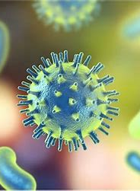
Pathogens are parasites
GTHBY Human Biology

Slide 2
Review
What is a pathogen?
Are all pathogens microorganisms?
List four categories of pathogens.
For each of the above, give an example of a disease they can cause?
Are all diseases caused by pathogens? Explain.
Are all microorganisms pathogens? Explain.

Slide 3
Learning Intentions
Types of pathogens and the diseases they cause

Slide 4
Success Criteria
Review pathogens (definition, categories, examples)
Define parasites
Define host and classify different types of host
Plan for investigation into bacteria and fungi

Slide 5
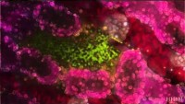

Slide 6
Questions
What type of pathogen is malaria?
What is the primary host of malaria?
What is the secondary host of malaria?
Are mosquitoes affected by malaria?

Slide 7
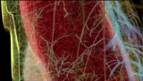

Slide 8
Questions
What is the advantage to the malaria parasite of having two hosts?
What do we mean by secondary host?
What is a cyst?
Why is it an advantage that the secondary host is not killed by the parasite?
What is it about malaria that can kill the primary host?

Slide 9
Parasites and hosts
Wordmatch activity

Slide 10
Investigation Task
Task 7: Investigation – Does the environment affect the growth of micro-organisms?

Slide 11
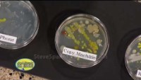

Slide 12
Investigation Task
Task 7: Investigation – Does the environment affect the growth of micro-organisms?
Independent Variable Ideas:
Dependent Variable Ideas:
Controlled Variable Ideas:
Safety Precautions:

